Slide 1


Slide 2

27
EXPENDITURE MULTIPLIERS
Notes:
Notes and teaching tips: 4, 11, 18, 20, 32, 34, 44, 46, 51, 59, 62, and 65.
To view a full-screen figure during a class, click the expand button.
To return to the previous slide, click the shrink button.
To advance to the next slide, click anywhere on the full screen figure.
Applying the principles of economics to interpret and understand the news is a major goal of the principles course. You can encourage your students in this activity by using the features called Economics in the News.
(1) Before each class, scan the news and select two or three headlines that are relevant to your session today. There is always something that works. Read the headline and ask for comments, interpretation, discussion. Pose questions arising from it that motivate today’s class. At the end of the class, return to the questions and answer them with the tools you’ve been explaining.
(2) Once or twice a semester, set an assignment, for credit, with the following instructions:
(a) Find a news article about an economic topic that you find interesting.
(b) Make a short bullet-list summary of the article.
(c) Write and illustrate with appropriate graphs an economic analysis of the key points in the article.
Use the Economics in the News features in your textbook as models.

Slide 3
After studying this chapter, you will be able to:
Explain how expenditure plans are determined
Explain how real GDP is determined at a fixed price level
Explain the expenditure multiplier
Explain the relationship between aggregate expenditure and aggregate demand

Slide 4
Fixed Prices and Expenditure Plans
  Keynesian model describes the economy in the very short run when prices are fixed.
  Because each firm’s price is fixed, for the economy as a whole:
  1. The price level is fixed.
  2. Aggregate demand determines real GDP.
  What determines aggregate expenditure plans?
Notes:
Historical background. If you want to talk about Keynes and his contribution to economics, this is probably the best place to do it. The part closer (p. 723) provides a brief biography of Keynes and sketches the essence of the distinction between Says Law and Keynes principle of effective demand. A more comprehensive Keynes biographical sketch can be found at http://cepa.newschool.edu/het/profiles/keynes.htm.
The model, now generally called the aggregate expenditure model, presented in this section is the essence of Keynes General Theory. According to Don Patinkin, a leading historian of economic thought and Keynes scholar says that the innovation of the General Theory was to replace price with income (GDP) as the equilibrating variable. This version of the model cannot be found in the General Theory, mainly because Keynes was writing before the national income accounting system had been developed. So he made up his own aggregates, based on employment and a money wage measure of the price level. But the words and equations of the General Theory can be translated readily into the textbook version of the model. This version of the model first appeared in Lorie Tarshis The Elements of Economics, a textbook published in 1947 . It was popularized by Paul Samuelson in the first edition of his celebrated text published in 1948.

Slide 5
Fixed Prices and Expenditure Plans
  Expenditure Plans
  The components of aggregate expenditure sum to real GDP.
  That is,
  Y = C + I + G + X – M
  Two of the components of aggregate expenditure, consumption and imports, are influenced by real GDP.
  So there is a two-way link between aggregate expenditure and real GDP.

Slide 6
Fixed Prices and Expenditure Plans
  Two-Way link Between Aggregate Expenditure and Real GDP
  Other things remaining the same,
  An increase in real GDP increases aggregate expenditure.
  An increase in aggregate expenditure increases real GDP.

Slide 7
Fixed Prices and Expenditure Plans
Consumption and Saving Plans
  Consumption expenditure is influenced by many factors but the most direct one is disposable income.
  Disposable income is aggregate income or real GDP, Y, minus net taxes, T.
  Call disposable income YD.
  The equation for disposable income is
  YD = Y – T

Slide 8
Fixed Prices and Expenditure Plans
  Disposable income, YD, is either spent on consumption goods and services, C, or saved, S.
  That is, YD = C + S.
  The relationship between consumption expenditure and disposable income, other things remaining the same, is the consumption function.
  The relationship between saving and disposable income, other things remaining the same, is the saving function.
  Figure 27.1 illustrates the consumption function and the saving function.

Slide 9
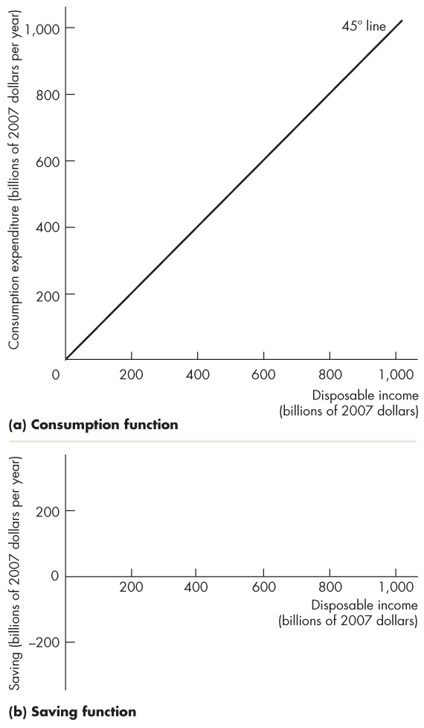
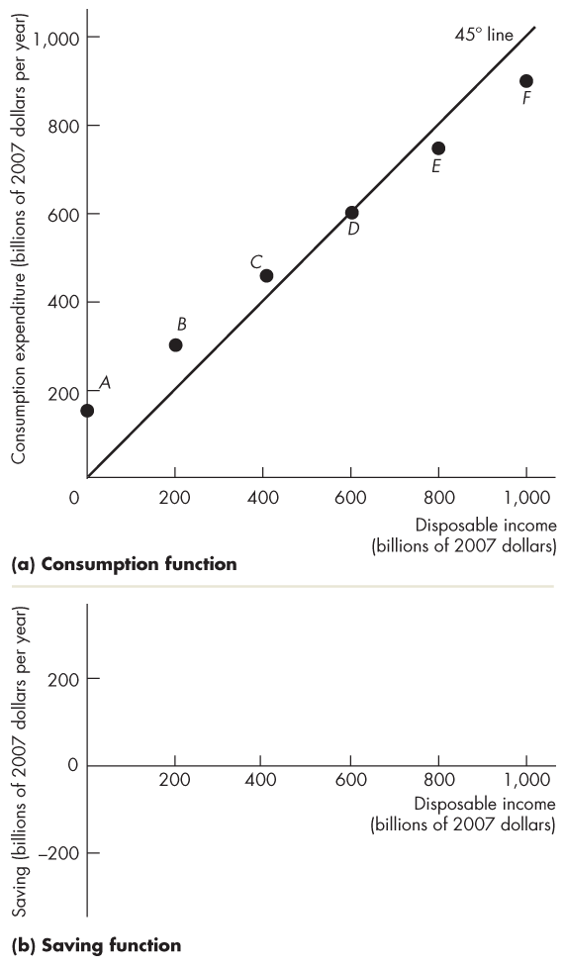
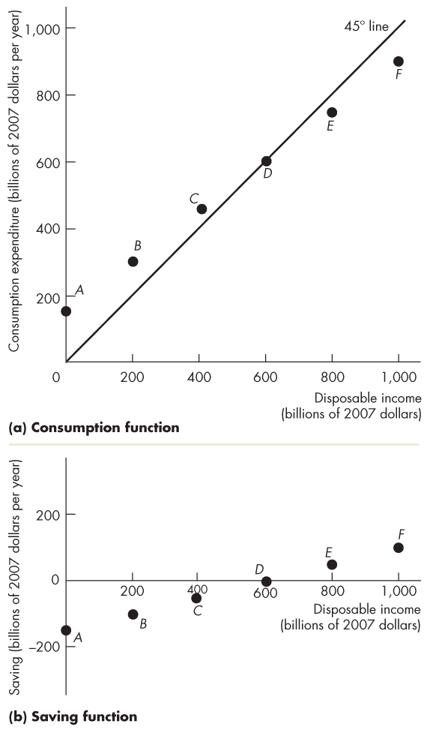
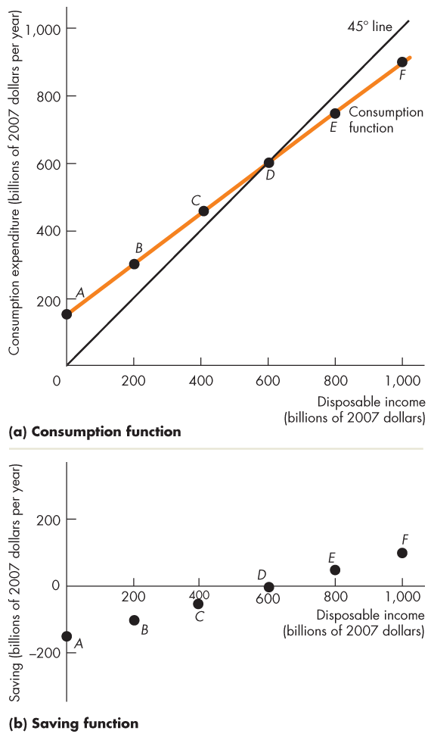
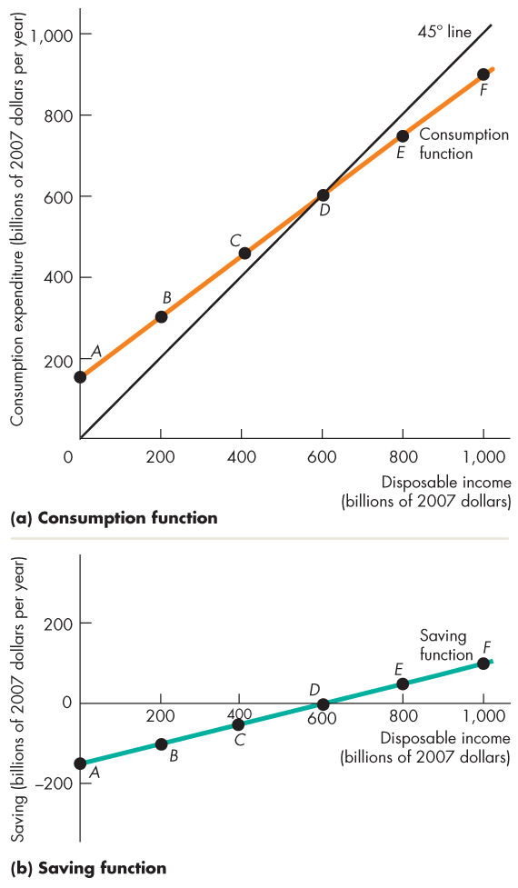
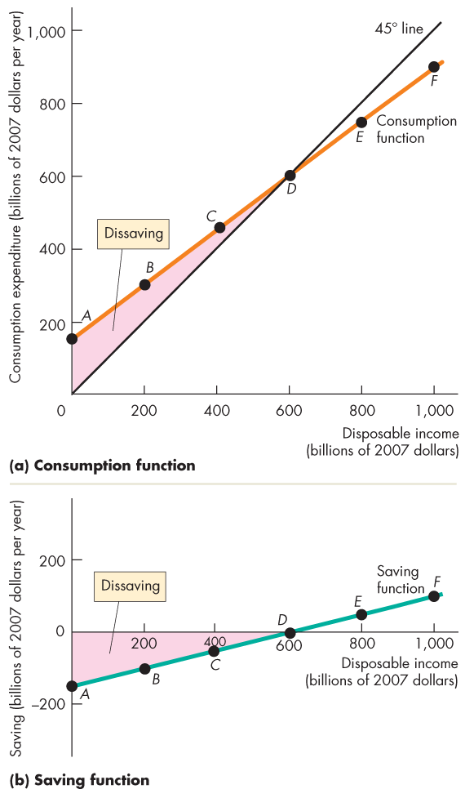
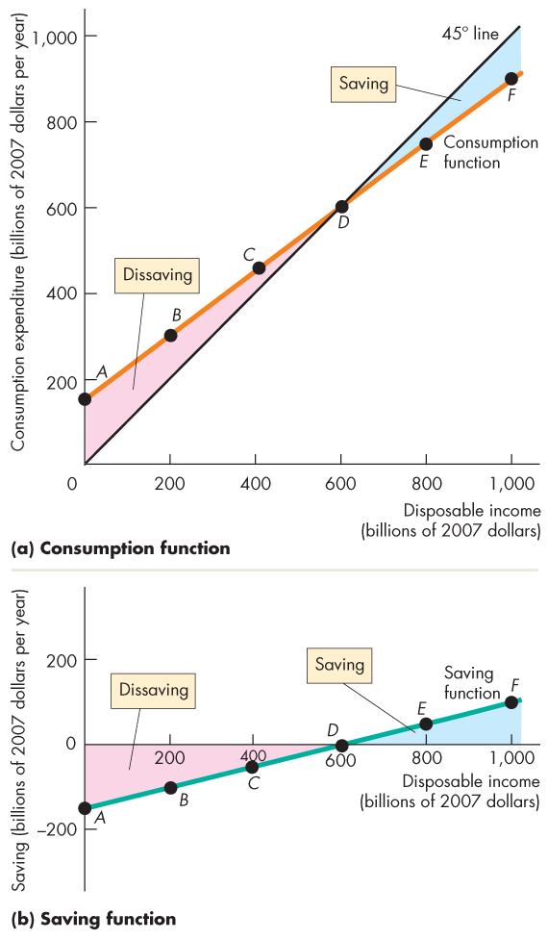
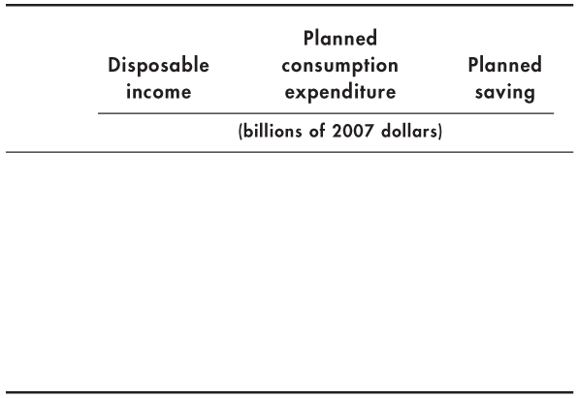
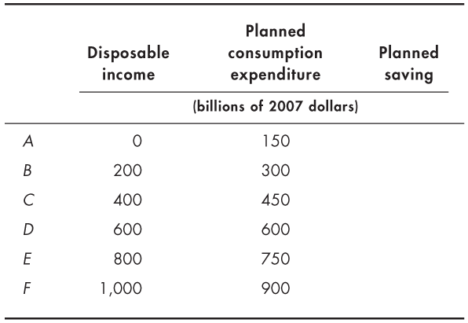
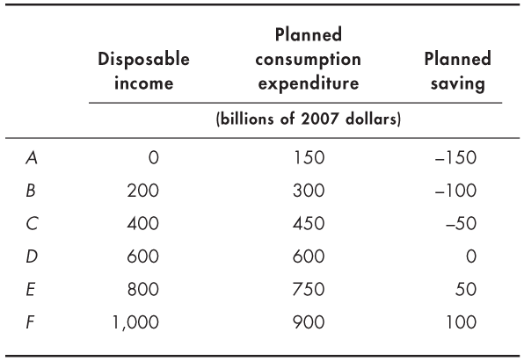
Fixed Prices and Expenditure Plans
  When consumption expenditure exceeds disposable income, saving is negative (dissaving).
  When consumption expenditure is less than disposable income, there is saving.

Slide 11
Fixed Prices and Expenditure Plans
Marginal Propensities to Consume and Save
  The marginal propensity to consume (MPC) is the fraction of a change in disposable income spent on consumption.
  It is calculated as the change in consumption expenditure, C, divided by the change in disposable income, YD, that brought it about.
  That is, MPC = C ÷ YD
Notes:
Marginal and average propensities. The text defines the MPC and MPS, and shows that they sum to one because disposable income can only be consumed or saved.
The textbook does not define and explain the APC and APS. These concepts have no operational significance and not worth bringing to the student’s attention.

Slide 12
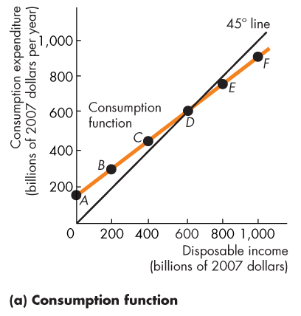
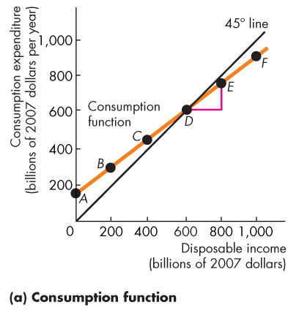
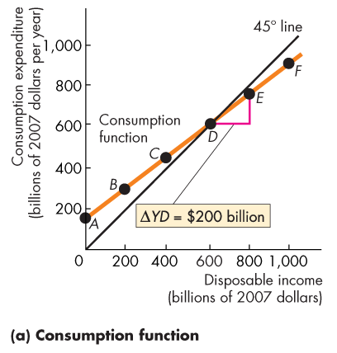
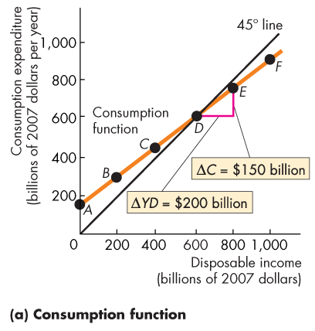
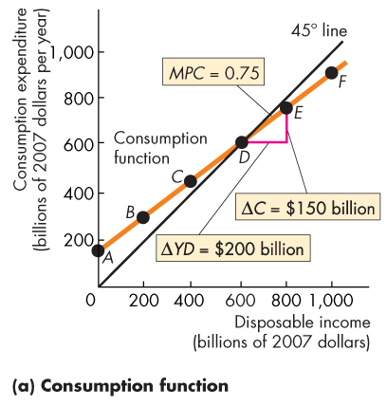
Fixed Prices and Expenditure Plans
  Figure 27.2(a) shows that the MPC is the slope of the consumption function.
  Along this consumption function, when disposable income increases by
  $200 billion, consumption expenditure increases by $150 billion.
  The MPC is 0.75.

Slide 13
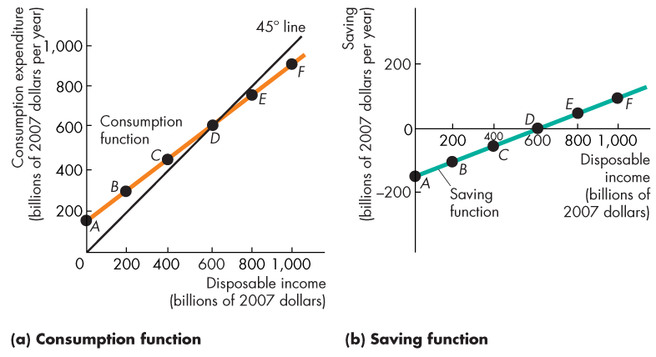
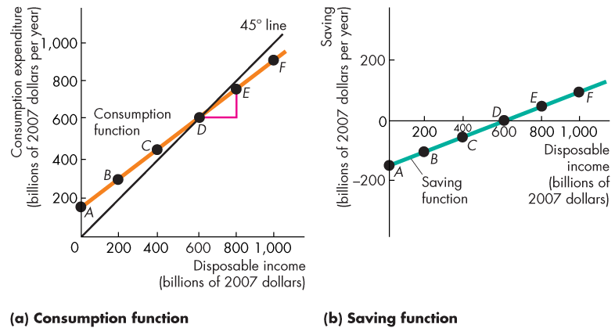
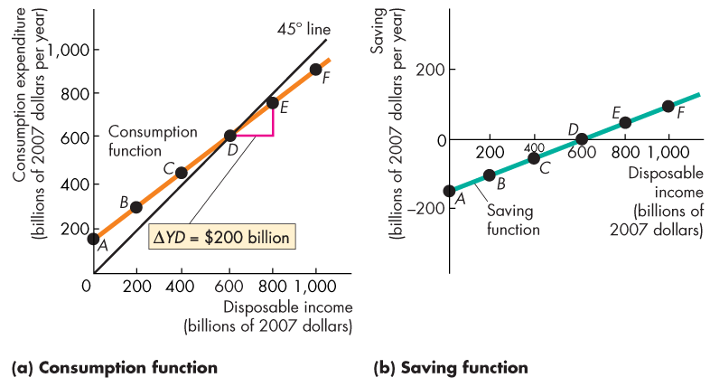
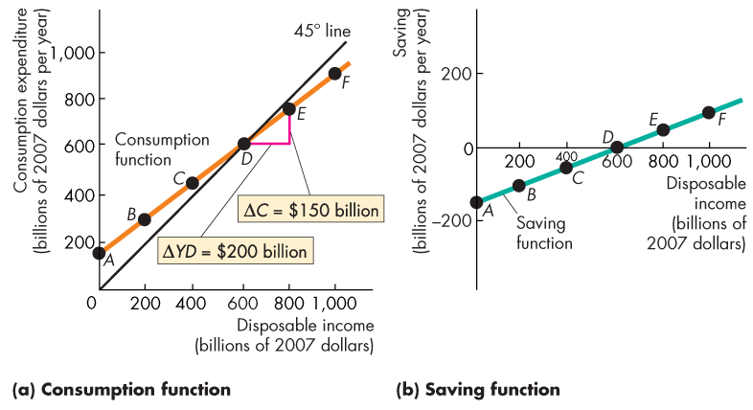
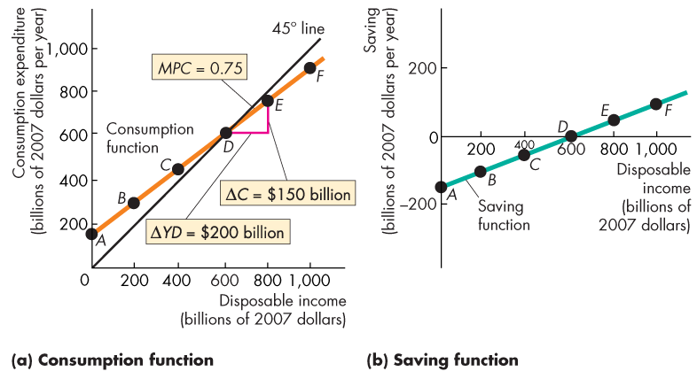

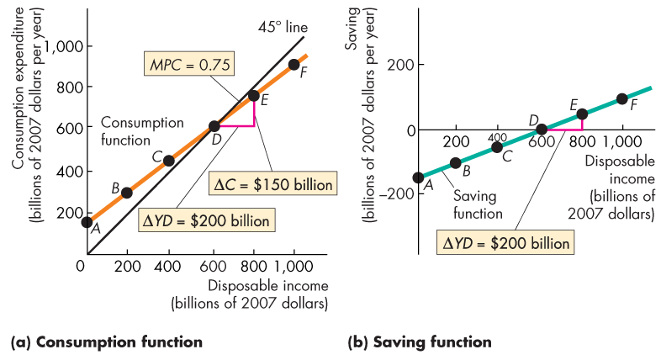
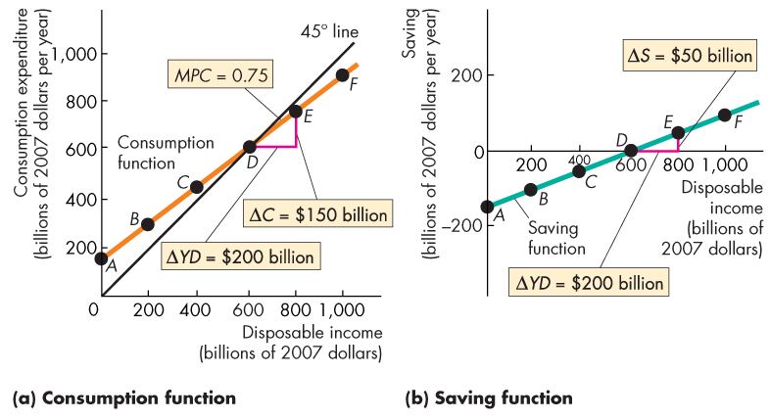
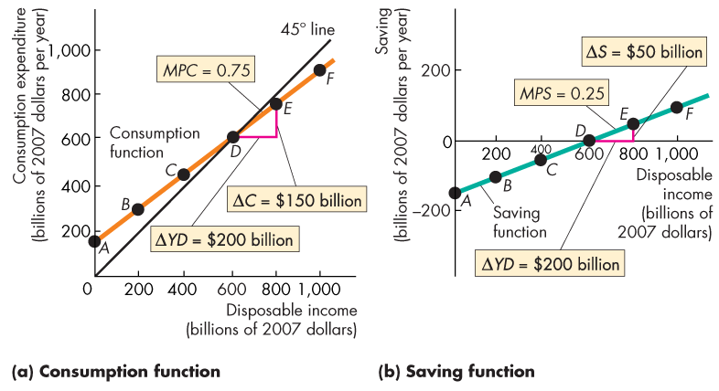

Slide 14
Fixed Prices and Expenditure Plans
  The marginal propensity to save (MPS) is the fraction of a change in disposable income that is saved.
  It is calculated as the change in saving, S, divided by the change in disposable income, YD, that brought it about.
  That is,
  MPS = S ÷ YD

Slide 15
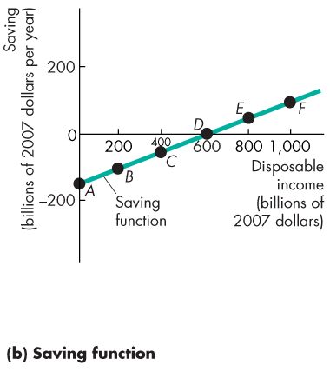
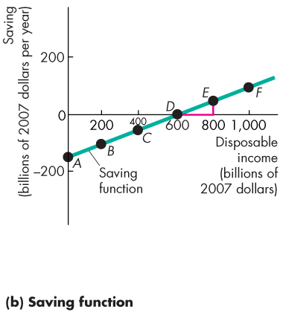
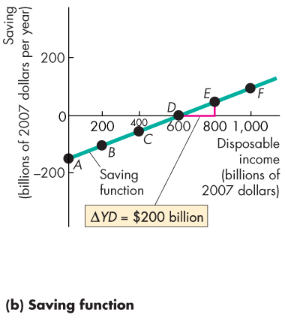
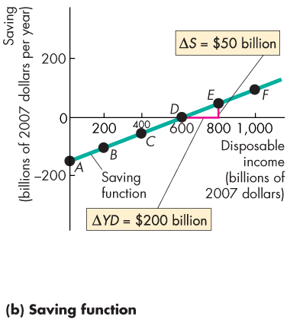
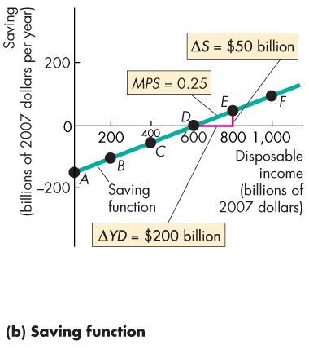
Fixed Prices and Expenditure Plans
  Figure 27.2(b) shows that the MPS is the slope of the saving function.
  Along this saving function, when disposable income increases by $200 billion, saving increases by
  $50 billion.
  The MPC is 0.25.

Slide 17
Fixed Prices and Expenditure Plans
  The MPC plus the MPS equals 1.
  To see why, note that,
  C + S = YD.
  Divide this equation by YD to obtain,
  C/YD + S/YD = YD/YD
  or
  MPC + MPS = 1.

Slide 18
Fixed Prices and Expenditure Plans
Consumption as a Function of Real GDP
  Disposable income changes when either real GDP changes or net taxes change.
  If tax rates don’t change, real GDP is the only influence on disposable income, so consumption expenditure is a function of real GDP.
  We use this relationship to determine real GDP when the price level is fixed.
Notes:
Classroom activity
Check out Economics in Action: The Canadian Consumption Function

Slide 19
Fixed Prices and Expenditure Plans
Import Function
  In the short run, Canadian imports are influenced primarily by Canadian real GDP.
  The marginal propensity to import is the fraction of an increase in real GDP spent on imports.
  If an increase in real GDP of $100 billion increases imports by $25 billion, the marginal propensity to import is 0.25.

Slide 20
Real GDP with a Fixed Price Level
  When the price level is fixed, aggregate demand is determined by aggregate expenditure plans.
  Aggregate planned expenditure is planned consumption expenditure plus planned investment plus planned government expenditure plus planned exports minus planned imports.
Notes:
The main difference between the Keynesian cross model of the 1940s and the aggregate expenditure model of today is that from the 1940s through the mid-1960s, economists believed that the fixed price level assumption was an acceptable (if not exactly accurate) description of reality, so the model was seen as actually determining real GDP, and the multiplier was seen as an empirically relevant phenomenon. In contrast, today, we see the model as part of the aggregate demand story. The value of the model today—and it is valuable today and not, as some people claim, eclipsed by the AS-AD model and irrelevant—is that it explains the multiplier that translates a change in autonomous expenditure into a shift of the AD curve and it explains the multiplier convergence process that pulls the economy towards the AD curve. (When an unintended change in inventories occurs, the economy is off the AD curve but moving towards it.)

Slide 21
Real GDP with a Fixed Price Level
  Planned consumption expenditure and planned imports are influenced by real GDP.
  When real GDP increases, planned consumption expenditure and planned imports increase.
  Planned investment plus planned government expenditure plus planned exports are not influenced by real GDP.

Slide 22
Real GDP with a Fixed Price Level
Aggregate Planned Expenditure
  The relationship between aggregate planned expenditure and real GDP can be described by an aggregate expenditure schedule, which lists the level of aggregate expenditure planned at each level of real GDP.
  The relationship can also be described by an aggregate expenditure curve, which is a graph of the aggregate expenditure schedule.

Slide 23
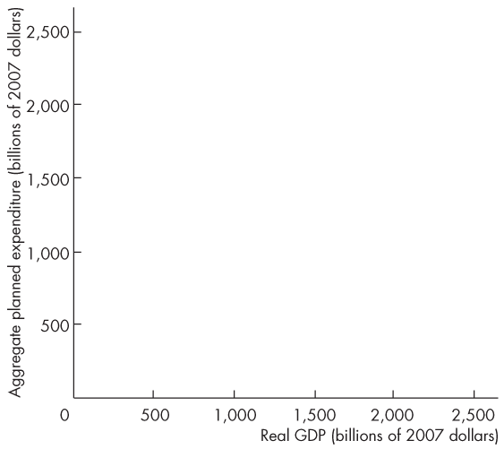
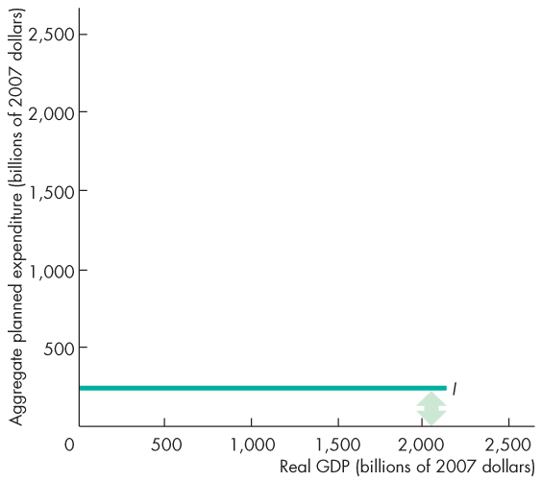
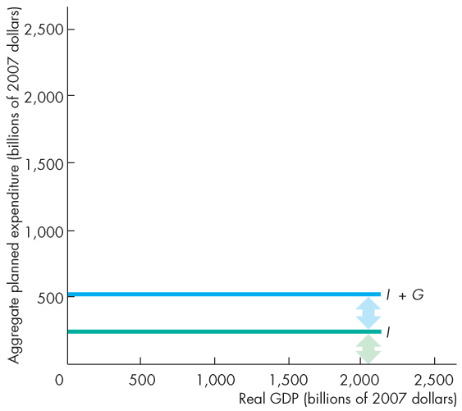
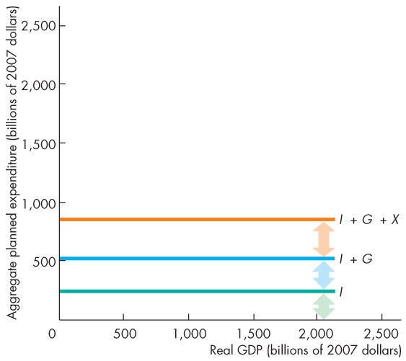
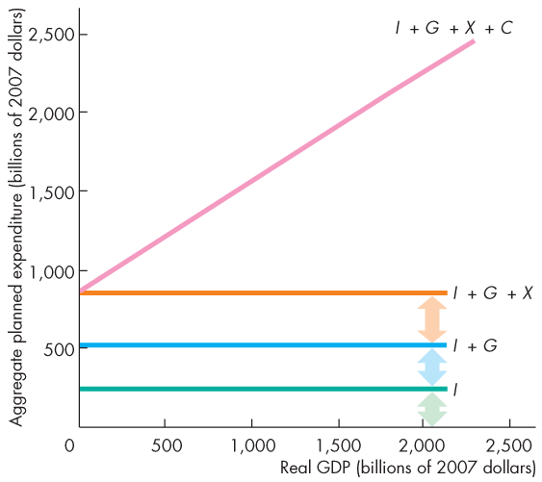
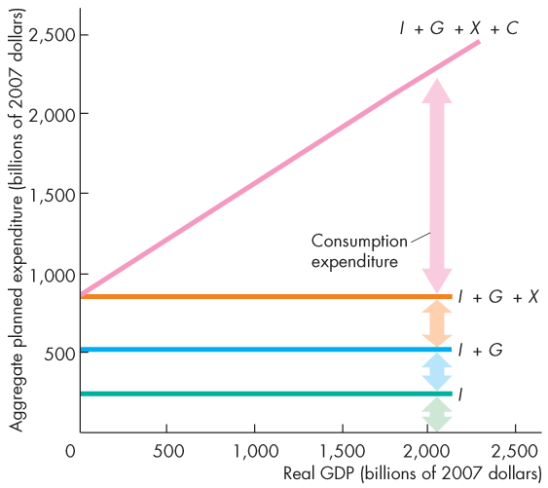
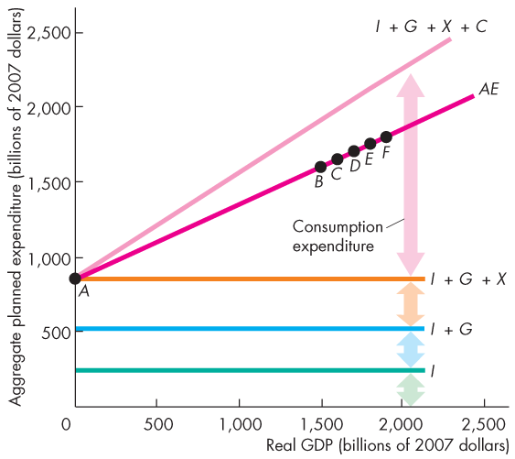
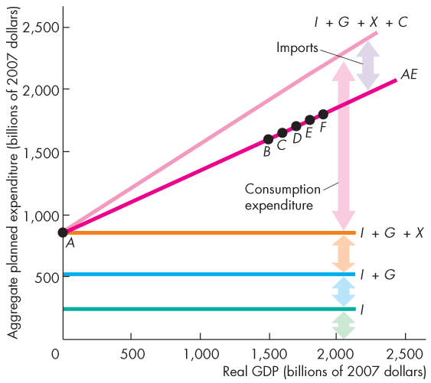
Real GDP with a Fixed Price Level
  Figure 27.3 shows how the aggregate expenditure curve (AE) is built from its components.

Slide 25
Real GDP with a Fixed Price Level
  Consumption expenditure minus imports, which varies with real GDP, is induced expenditure.
  The sum of investment, government expenditure, and exports, which does not vary with GDP, is autonomous expenditure.
  (Consumption expenditure and imports can have an autonomous component.)

Slide 26
Real GDP with a Fixed Price Level
Actual Expenditure, Planned Expenditure, and
Real GDP
  Actual aggregate expenditure is always equal to real GDP.
  Aggregate planned expenditure may differ from actual aggregate expenditure because firms can have unplanned changes in inventories.
Equilibrium Expenditure
  Equilibrium expenditure is the level of aggregate expenditure that occurs when aggregate planned expenditure equals real GDP.

Slide 27
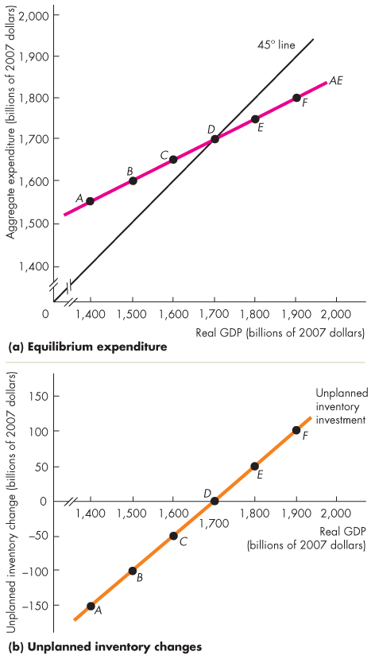
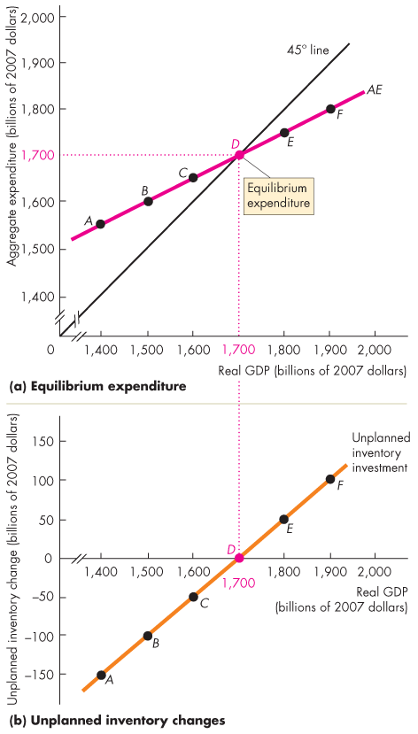
Real GDP with a Fixed Price Level
  Figure 27.4 illustrates equilibrium expenditure.
  Equilibrium occurs at the point at which the aggregate expenditure curve crosses the 45° line in part (a).
  Equilibrium occurs when there are no unplanned changes in business inventories in part (b).

Slide 28

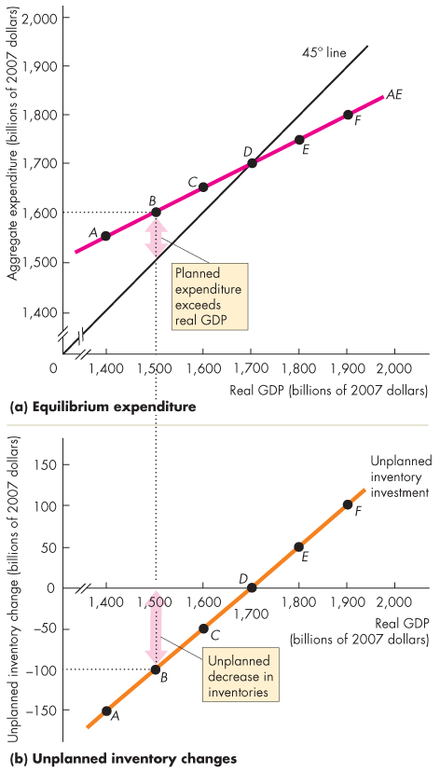
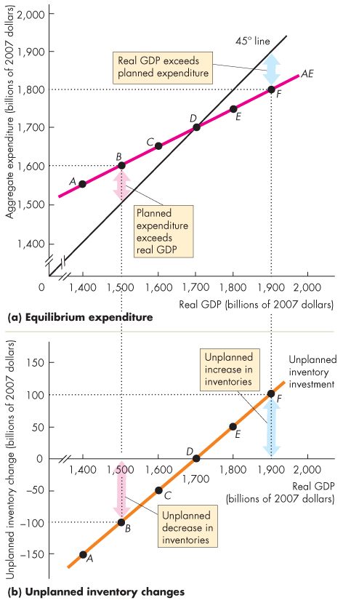
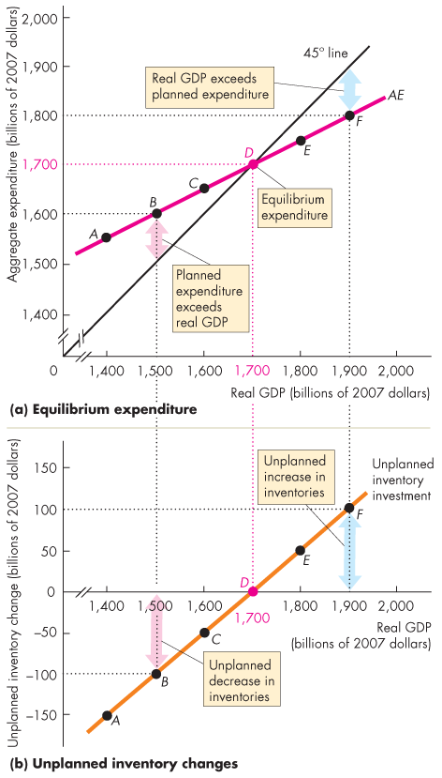

Slide 29
Real GDP with a Fixed Price Level
Convergence to Equilibrium
  If aggregate planned expenditure exceeds real GDP (the AE curve is above the 45° line), …
  there is an unplanned decrease in inventories.
  To restore inventories, firms hire workers and increase production.
  Real GDP increases.

Slide 30
Real GDP with a Fixed Price Level
  If aggregate planned expenditure is less than real GDP (the AE curve is below the 45° line), …
  there is an unplanned increase in inventories.
  To reduce inventories, firms fire workers and decrease production.
  Real GDP decreases.

Slide 31
Real GDP with a Fixed Price Level
  If aggregate planned expenditure equals real GDP (the AE curve intersects the 45° line), …
  there is no unplanned change in inventories.
  So firms maintain their current production.
  Real GDP remains constant.

Slide 32
The Multiplier
  When autonomous expenditure changes, so does equilibrium expenditure and real GDP.
  But the change in equilibrium expenditure is larger than the change in autonomous expenditure.
  The multiplier is the amount by which a change in autonomous expenditure is magnified or multiplied to determine the change in equilibrium expenditure and real GDP.
Notes:
The basic idea and practice. Students need quite a lot of practice using multipliers. One good problem involves working out the effects on consumption as well as GDP of a change in investment (when the price level is fixed). The best way to present this problem to the students seems to be sequentially. Begin by giving them the data necessary to deduce how real GDP changes from an increase in investment. Tell them there is no foreign trade, so that there are no exports or imports, and no income taxes. Tell them that the marginal propensity to consume is b (pick any valid number you like), and that investment has changed by ∆I (pick any valid number you like).
Then, after the students have computed the change in GDP, ask them what the change in consumption expenditure is.
Review their attempts to answer this question as follows: The change in GDP, ∆Y, is given by the equation: ∆Y = ∆C + ∆I. Given ∆I from the initial statement of the problem and ∆Y from the first set of calculations, the students can readily calculate ∆C. Focusing the students’ attention on the change in consumption is important because it reinforces the point that a change in autonomous expenditure (investment in this example) leads to an induced change in consumption expenditure and that this increase in consumption expenditure is the source of the multiplier.
The multiplier and the circular flow. Some instructors like to illustrate the multiplier, and give context to Figure 27.8, by using a circular flow diagram to trace out the effect round by round of an initial change in autonomous expenditure. If you do this exercise, use the concrete numbers of Figure 27.8 and initially omit consideration of government and the rest of the world.

Slide 33
The Multiplier
The Basic Idea of the Multiplier
  An increase in investment (or any other component of autonomous expenditure) increases aggregate expenditure and real GDP.
  The increase in real GDP leads to an increase in induced expenditure.
  The increase in induced expenditure leads to a further increase in aggregate expenditure and real GDP.
  So real GDP increases by more than the initial increase in autonomous expenditure.

Slide 34
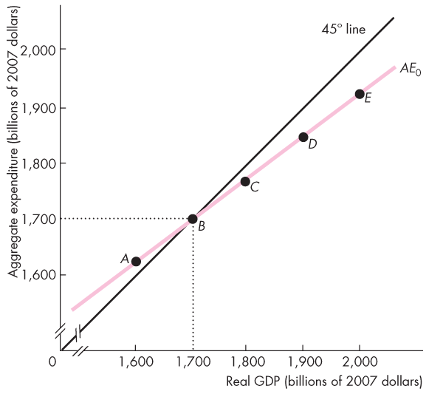
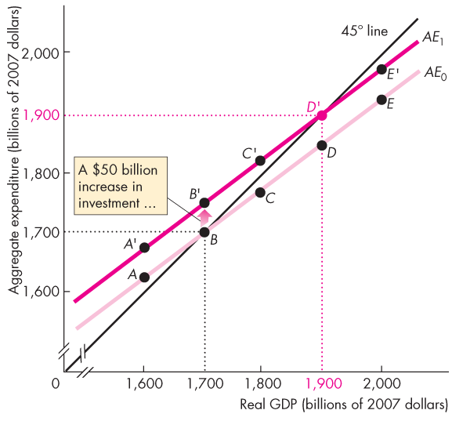
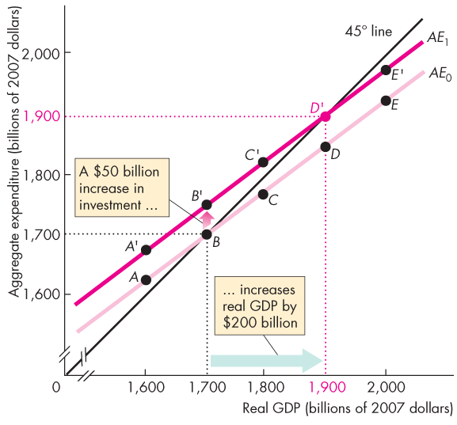
The Multiplier
  Figure 27.5 illustrates the multiplier.
  An increase in autonomous expenditure brings an unplanned decrease in inventories.
  So firms increase production.
  Real GDP increases to a new equilibrium.
Notes:
Classroom activity
Check out Economics in the News: Expenditure Changes in 2014 Expansion

Slide 36
The Multiplier
Why Is the Multiplier Greater than 1?
  The multiplier is greater than 1 because an increase in autonomous expenditure induces further increases in aggregate expenditure.
The Size of the Multiplier
  The size of the multiplier is the change in equilibrium expenditure divided by the change in autonomous expenditure.

Slide 37
The Multiplier
The Multiplier and the Slope of the AE Curve
  The slope of the AE curve determines the magnitude of the multiplier:
  Multiplier = 1 ÷ (1 – Slope of AE curve)
  If the change in real GDP is ΔY, the change in autonomous expenditure is ΔA, and the change in induced expenditure is ΔN, then
  Multiplier = ΔY ÷ ΔA

Slide 38
The Multiplier
  To see why the multiplier = 1 ÷ (1 – Slope of AE curve), begin with the fact that:
  ΔY = ΔN + ΔA
  But
  Slope of AE curve = ΔN ÷ ΔY
  so,
  ΔN = (Slope of AE curve x ΔY)
  Now replace ΔN in the first equation
  ΔY = (Slope of AE curve x ΔY) + ΔA

Slide 39
The Multiplier
  ΔY = (Slope of AE curve x ΔY) + ΔA
  Re-arrange as
  (1 − Slope of AE curve) x ΔY = ΔA
  and
  ΔY = ΔA ÷ (1 − Slope of AE curve)
  Multiplier = ΔY ÷ ΔA
  So Multiplier = 1 ÷ (1 − Slope of AE curve)

Slide 40
The Multiplier
  With the numbers in Figure 27.5, the slope of the AE curve is 0.75, so the multiplier is
  ΔY ÷ ΔA = 1 ÷ (1 − 0.75) = 1 ÷ (0.25) = 4.
  When there are no income taxes and no imports, the slope of the AE curve equals the marginal propensity to consume, so the multiplier is
  Multiplier = 1 ÷ (1 − MPC).
  But 1 – MPC = MPS, so the multiplier is also
  Multiplier = 1 ÷ MPS.

Slide 41
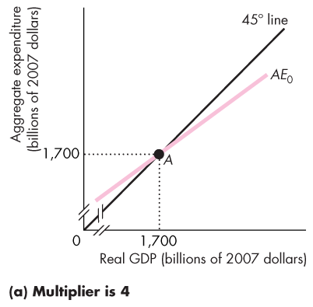
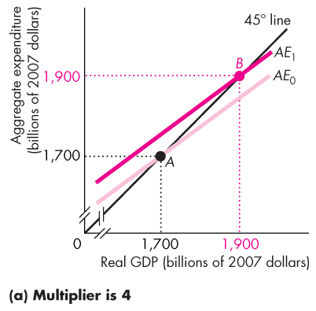
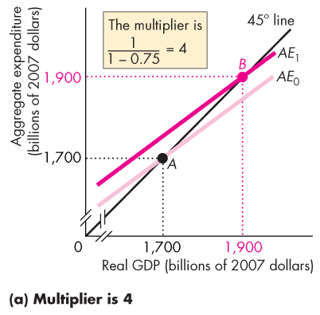
The Multiplier
Imports and Income Taxes
  Both imports and income taxes reduce the size of the multiplier.
  Figure 27.6 shows how.
  In part (a) with no taxes or imports, the slope of the AE curve is 0.75 and the multiplier is 4.

Slide 42
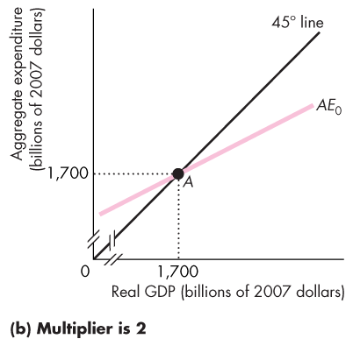
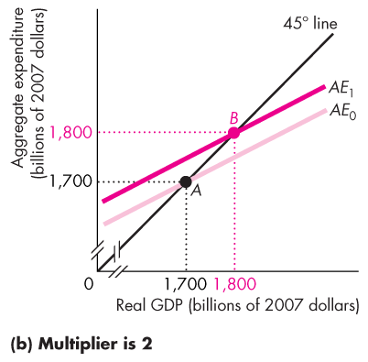
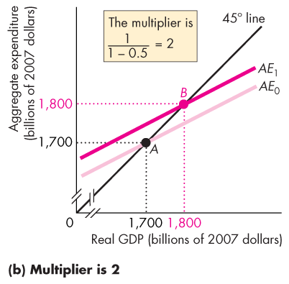

Slide 43
The Multiplier
  In part (b), with taxes and imports, the slope of the AE curve is 0.5 and the multiplier is 2.

Slide 44




























The Multiplier
  The Multiplier Process
  Figure 27.7 illustrates the multiplier process.
  The MPC determines the magnitude of the amount of induced expenditure at each round as aggregate expenditure moves towards equilibrium expenditure.
Notes:
Classroom activity
Check out Economics in Action: The Multiplier in the Great Depression

Slide 46
The Multiplier
  ∆Y = ∆I + b∆I + b²∆I + b³∆I + b⁴∆I + b⁵∆I + ….
  (where b = slope of AE curve). Multiply by b to obtain
  b∆Y = b∆I + b²∆I + b³∆I + b⁴∆I + b⁵∆I + ….
  b^{n} approaches zero as n becomes large so b^{(n + 1)} also approaches zero.
  Subtract the second equation from the first to obtain
  ∆Y – b∆Y = ∆I, or (1 – b) ∆Y = ∆I,
  so that
  ∆Y = ∆I ÷ (1 – b).
Notes:
The math of the multiplier process. Some instructors like to illustrate that the multiplier is the sum of the increments at each “round” in the multiplier process. This illustration teaches the student the neat facts about the sum of a convergent geometric series.
[To use this slide, unhide it by clicking Slide Show, Hide Slide]

Slide 47
The Multiplier
Business Cycle Turning Points
  Turning points in the business cycle—peaks and troughs—occur when autonomous expenditure changes.
  An increase in autonomous expenditure brings an unplanned decrease in inventories, which triggers an expansion.
  A decrease in autonomous expenditure brings an unplanned increase in inventories, which triggers a recession.

Slide 48
The Multiplier and the Price Level
  Adjusting Quantities and Prices
  Real firms don’t hold their prices constant for long.
  When firms have an unplanned change in inventories, they change production and prices.
  And the price level changes when firms change prices.
  The AS-AD model explains the simultaneous determination of real GDP and the price level.
  The two models are related.

Slide 49
The Multiplier and the Price Level
Aggregate Expenditure and Aggregate Demand
  The aggregate expenditure curve is the relationship between aggregate planned expenditure and real GDP, with all other influences on aggregate planned expenditure remaining the same.
  The aggregate demand curve is the relationship between the quantity of real GDP demanded and the price level, with all other influences on aggregate demand remaining the same.

Slide 50
The Multiplier and the Price Level
Deriving the Aggregate Demand Curve
  When the price level changes, a wealth effect and substitution effects change aggregate planned expenditure and change the quantity of real GDP demanded.
  Figure 27.8 on the next slide illustrates the effects of a change in the price level on the AE curve, equilibrium expenditure, and the quantity of real GDP demanded.

Slide 51


The Multiplier and the Price Level
  In Figure 27.8(a), a rise in price level from 110 to 130 …
  shifts the AE curve from AE₀ downward to AE₁ and …
  decreases equilibrium expenditure from
  $1,700 billion to $1,600 billion.
Notes:
The mechanics of the relationship between the AE and AD curves. Students need a lot of help and clear explanation of the mechanics of the link between these two curves. Here’s what to stress:
1. The AE curve shows how aggregate planned expenditure depends on real GDP (through the effects of disposable income), other things remaining the same.
2. The AD curve shows how equilibrium aggregate expenditure depends on the price level, other things remaining the same.
The next two points are really hard for students:
3. A change in the price level changes autonomous expenditure, which shifts the AE curve, generates a new level of equilibrium expenditure, and generates a new point on the AD curve—Figure 27.10.
4. A change in autonomous expenditure at a given price level shifts the AE curve, generates a new level of equilibrium expenditure, and shifts the AD curve by an amount equal to the change in autonomous expenditure multiplied by the multiplier.
Explain these last two points very painstakingly and illustrate them with Figure 27.10 and Figure 27.11.

Slide 52




Slide 53
The Multiplier and the Price Level
  In Figure 27.8(b), the same rise in the price level that lowers equilibrium expenditure …
  brings a movement along the AD curve from point B to point A.

Slide 54
The Multiplier and the Price Level
  A fall in price level from 110 to 90 …
  shifts the AE curve from AE₀ upward to AE₂ and …
  increases equilibrium expenditure from
  $1,700 billion to $1,800 billion.

Slide 55
The Multiplier and the Price Level
  The same fall in the price level that increases equilibrium expenditure …
  brings a movement along the AD curve to from point B to point C.

Slide 56
The Multiplier and the Price Level
  Points A, B, and C on the
  AD curve correspond to the equilibrium expenditure points A, B, and C at the intersection of the AE curve and the 45° line.

Slide 57




The Multiplier and the Price Level
  Changes in Aggregate Expenditure and Aggregate Demand
  Figure 27.9 illustrates the effects of an increase in investment.
  The AE curve shifts upward …
  …and the AD curve shifts rightward …
  by an amount equal to the change in investment multiplied by the multiplier.

Slide 59

The Multiplier and the Price Level
Equilibrium Real GDP and the Price Level
  Figure 27.10 shows the effect of an increase in investment in the short run when the price level changes and the economy moves along its SAS curve.
Notes:
The key point. Emphasize the key point of this section: That the AE model and the multiplier tell us how far the AD curve shifts when autonomous expenditure changes and the multiplier process as expenditure and GDP respond to unplanned changes in inventories bring real GDP and the price level to a new equilibrium.

Slide 60






Slide 61


The Multiplier and the Price Level
  The increase in investment shifts the AE curve upward and shifts the AD curve rightward.
  With no change in the price level, real GDP would increase to $1,900 billion at point B.

Slide 62


The Multiplier and the Price Level
  But the price level rises.
  The AE curve shifts downward….
  Equilibrium expenditure decreases to $1,830 billion.
  As the price level rises, real GDP increases along the SAS curve to $1,830 billion.
  The multiplier in the short run is smaller than when the price level is fixed.
Notes:
The multiplier in the short run. By doing a careful job in explaining the effects of a change in autonomous expenditure on the AE curve, equilibrium expenditure, and the AD curve, you’ve laid the ground for your students to see how the multiplier is modified by a change in the price level in the adjustment to a new short-run equilibrium. Using Figure 27.10 as the illustration, tell the story like this:
1. The initial equilibrium is at point A on AE₀ and AD₀.
2. An increase in autonomous expenditure shifts the AE curve to AE₁ and shifts the AD curve to AD₁.
3. At the initial equilibrium price level, equilibrium expenditure and real GDP are at point B.
4. The economy is still at point A, but the new expenditure equilibrium is at point B.
5. Because firms are producing at point A but planned expenditure has increased, an unplanned decrease in inventories occurs.
6. With lower than planned inventories, firms increase production and raise prices. The economy moves along the SAS curve as real GDP increases and the price level rises.
7. The rising price level lowers aggregate planned expenditure and the AE curve shifts downward from AE₁ towardss AE₂.
8. So long as real GDP is to the left of the AD curve, aggregate planned expenditure exceeds actual expenditure, there is an unplanned decrease in inventories, and real GDP rises.
9. Eventually, real GDP increases and the price level rises to point C, where there is a new short-run equilibrium.

Slide 63



The Multiplier and the Price Level
  Figure 27.11 illustrates the long-run effects.
  At point C in part (b), there is an inflationary gap.
  The money wage rate starts to rise and the SAS curve starts to shift leftward.

Slide 64







Slide 65
The Multiplier and the Price Level
  The money wage rate will continue to rise and the SAS curve will continue to shift leftward, until real GDP equals potential real GDP.
  In the long run, the multiplier is zero.
Notes:
The multiplier in the long run. This analysis is a repeat of what you covered earlier in the AS-AD chapter and is reinforcement. The key point to emphasize is that there is no multiplier if we start at full employment.
The multiplier is not an empirically relevant concept until it is combined with information about the state of the economy relative to full employment.

